Slide 1


Challenge 1
Predict the faults across a given 2D seismic dataset.

Slide 2




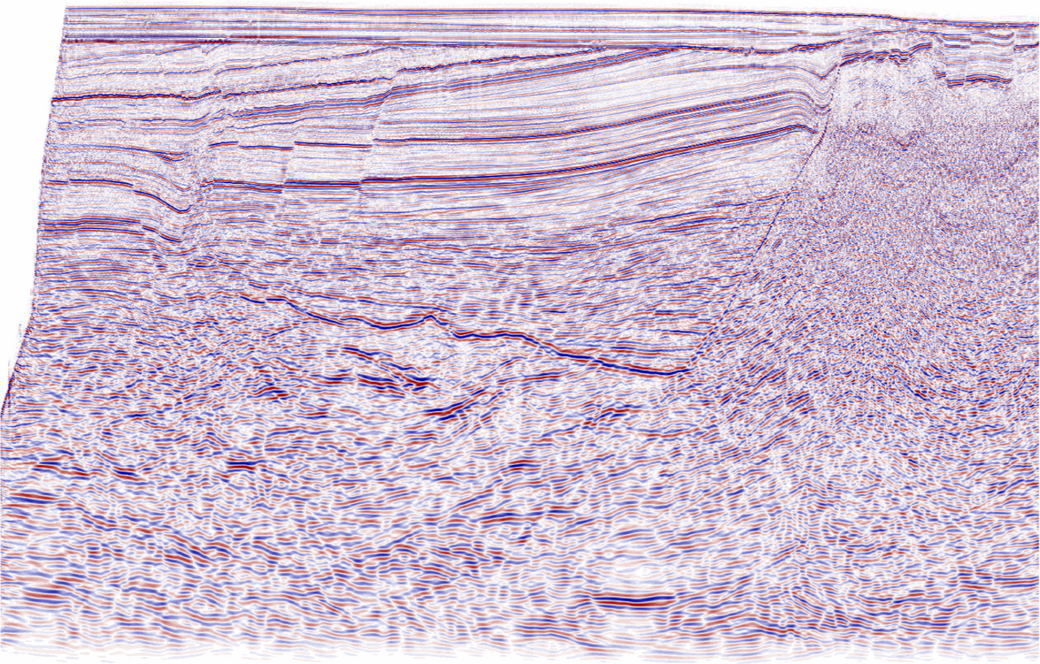
01 – Meeting between Nigel and Rachael
2. Hi Mr Nigel. OMG! We have to stop them. Looking at some of the seismic images, Fault Block A and Fault Block B is clearly divided by a fault
But interpreting seismic for the whole field is so time consuming. It would take months, if not a year!
3. I have an IDEA. We can leverage our in-house DS team to built an AI tool
We have some interpreted seismic from our older field that we can use as dataset!
Racheal, Ambitious Geoscientist
Seismic datasets
439 seismic images.
364 faults images, including 2 faults with missing seismic images.
Only 362 seismic/faults images used.
Train/Test split: 66% Train/33% Test
Producer A
Producer B
Mr. Nigel, Geoscience Mgr
Data Rich Oil Company
Injector A
Injector B
1. Hey Rachael, the reservoir team are on an active drilling campaign and planned to drill 2 additional water injectors to support our production in our newly discovered field ZZZ. They are going to contact the rig in 2 weeks!

Slide 3

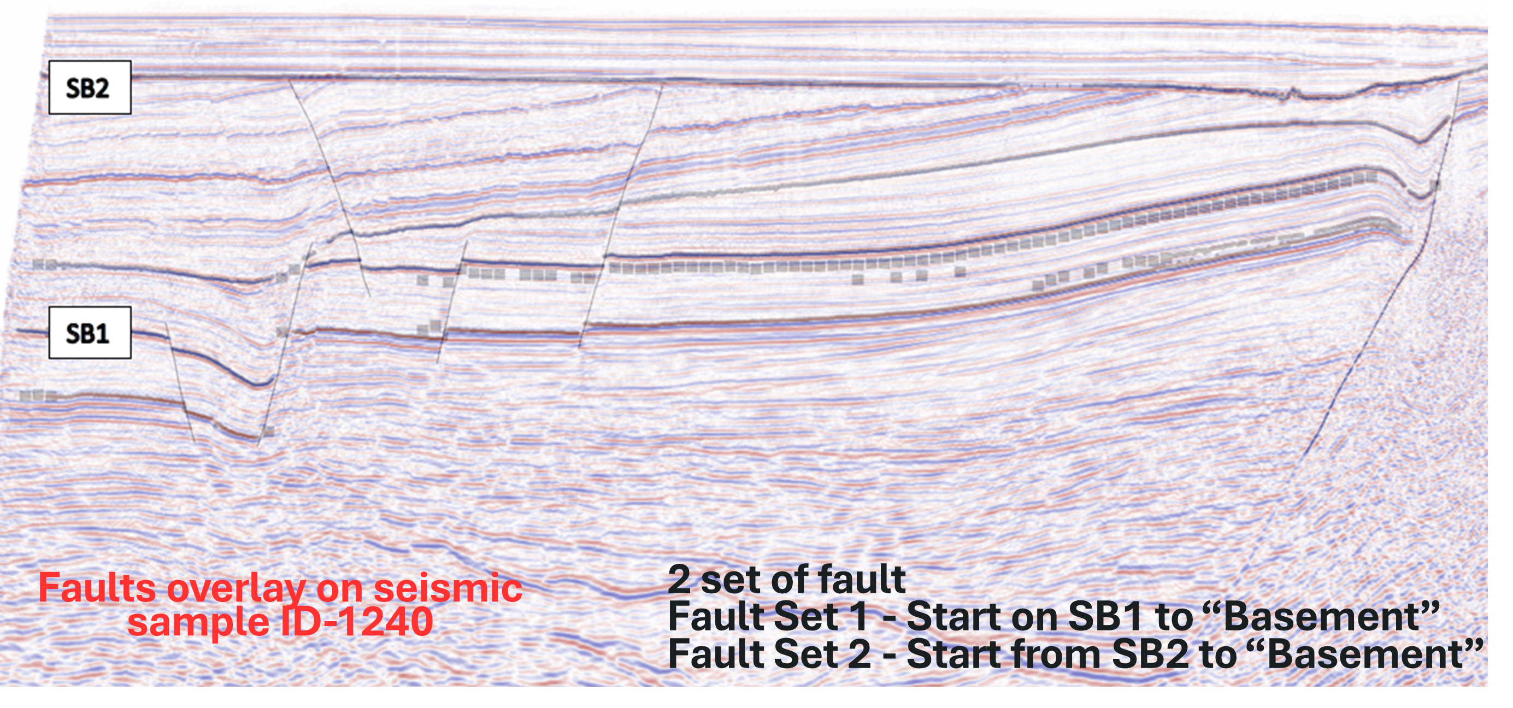
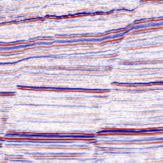
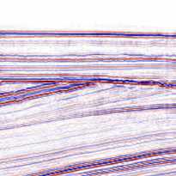
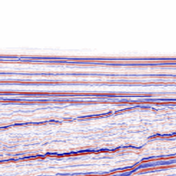
02 – The next day…….
1. Hey Rachael, this is an impossible task! The given dataset is so imbalance. There is no incentive to force our model to accurately match the fault
Data Science Team
2. Hi Team!
I think we should pre-process our input data prior to training. Do you think we should discretize the dataset?
Also, we should use Focal Loss since the dataset is heavily imbalanced. Maybe hyperparameter tuning on the loss function will help ?
Racheal, Very Ambitious Geoscientist
Image Discretization – To increase focus on imbalance dataset and increases the amount of dataset

Slide 4
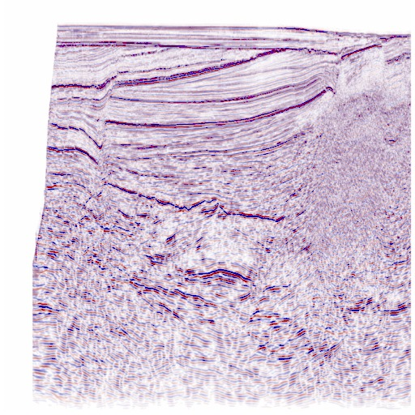
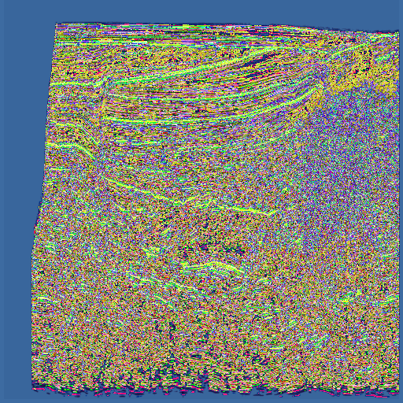
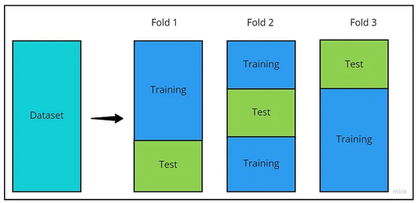
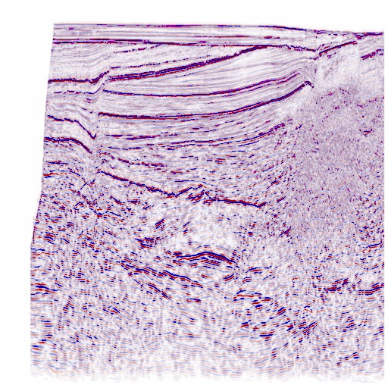
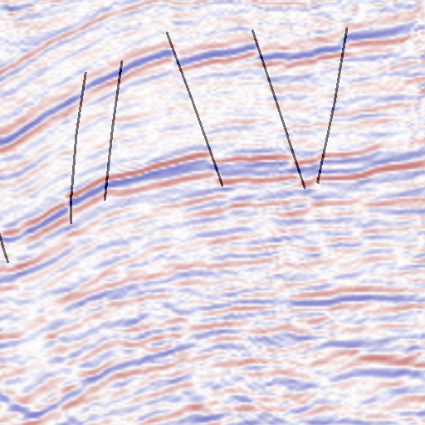

03 – Methodology (Data Pre-Processing)
Image Enhancement
Normalization & Contrast
Before
Data Science Team
Cross Validation
1. That’s a really good idea. We can increase
After
2. What do you think of the idea of increasing the width of the labels ?
It doesn’t change the geology but will significantly help our model
Key Differentiators:
Tailored Pre-processing steps for seismic image
Enhancing Seismic Reflector
Wider fault to help interpretability
Addressing imbalanced data
Fault “Thickening”

Slide 5
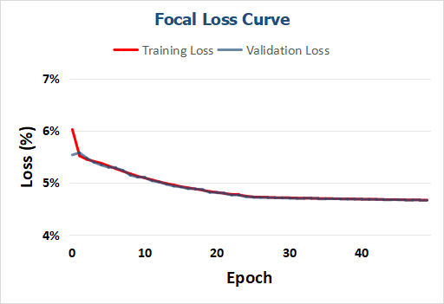
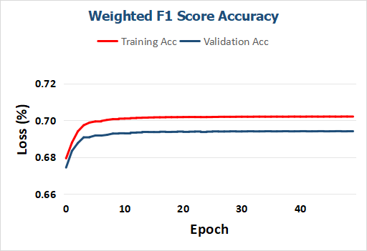

03 - Model Performance
04 - Results
Our Model - CrackNet
That’s really impressive.
All our pre-processing work paid off
The CrackNet model is now able to capture the faults really well
Epochs: 50
Image Size: 512 x 512
Batch Size: 6
Learning Rate: 0.0001
Evaluation Matrix: Weighted F1 Score (Addressing imbalanced data)
Loss: Enhanced Focal Loss with alpha
Loss: 5%
F1 Score: 70%
Our model CrackNet performance on the validation dataset with 3 folds cross validation

Slide 6
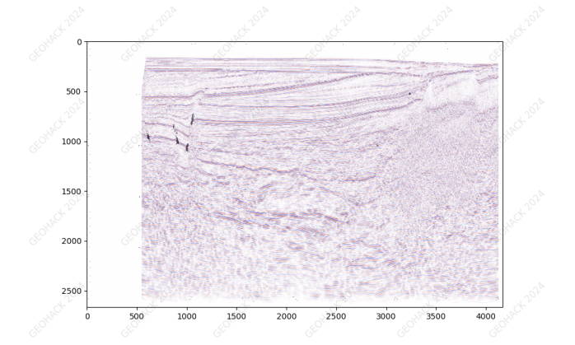
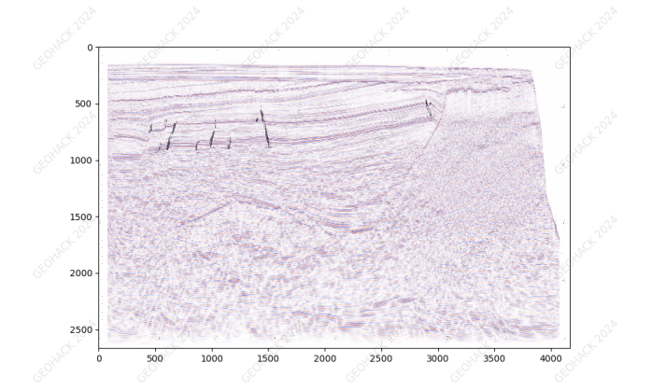
05 - Visualization of results
on holdout data
Model is

Slide 7
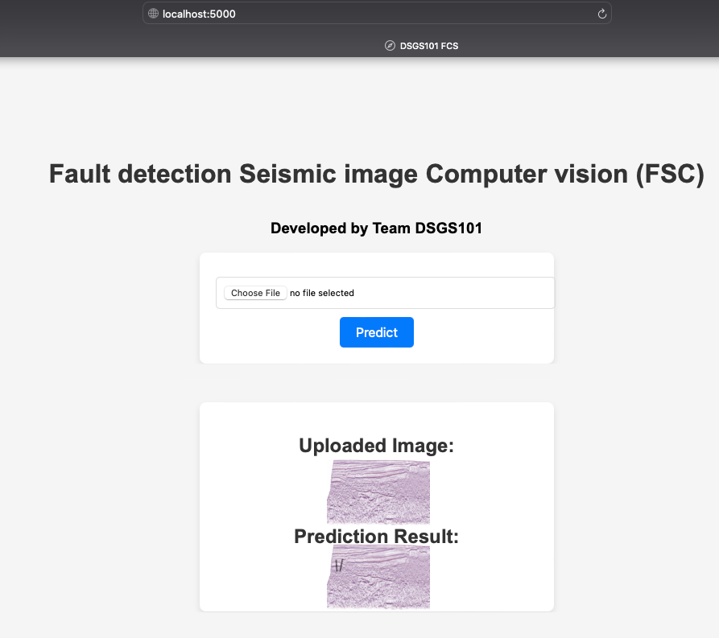
06 - How to interface with the model?
Web application developed with Python Flask framework.
The end user will upload their seismic image into the tool and the model will generate the fault that overlays on top of the seismic image.
1. Great job, team!

Slide 8



Slide 9
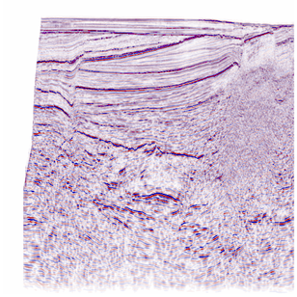
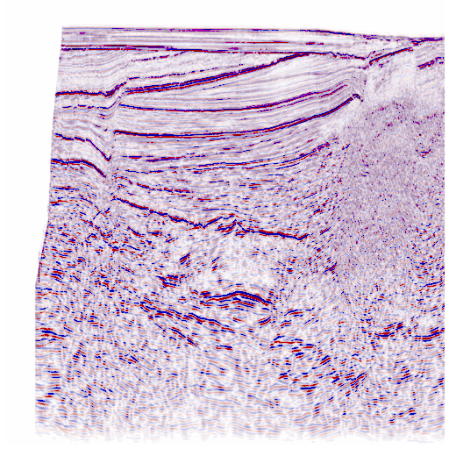

03 - Methodology
The HOW?
Data Pre-processing
Ensure important feature are fed into the model
Improve training set label area
Data Science Team
Image Size Reduction
Image Enhancement
Normalization & Contrast
“Thickening” Fault
Cross Validation
Reduces memory usage
Ensure model compatibility
increase the datasets size and focus on the contours
Image Cropping
Our Differentiator
Our Model - CrackNet
Epochs: 50
Image Size: 512 x 512
Batch Size: 6
Learning Rate: 0.0001
Evaluation Matrix: Weighted F1 Score (Addressing imbalanced data)
Loss: Enhanced Focal Loss with alpha
Tailored Pre-processing steps for seismic image
Enhancing Seismic Reflector
Wider fault to help interpretability
Addressing imbalanced data

Slide 10
BACK-UP

